Slide 1

Heart Failure Prediction

Slide 2
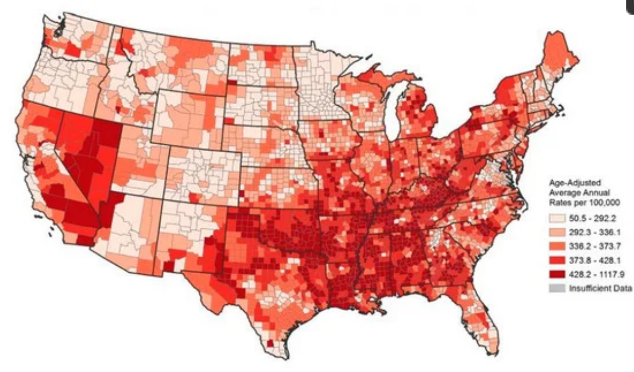
INTRODUCTION
Context: Cardiovascular diseases (CVDs) are the leading cause of death globally, claiming 17.9 million lives annually (31% of all deaths). Early detection is critical, and machine learning models can play a pivotal role in risk prediction and management.
Dataset Details:
Total Observations: 918 (after removing 272 duplicates).
Features: 11 attributes like age, sex, chest pain type, cholesterol, max heart rate, and more.
Target Variable: Heart Disease (1 = disease, 0 = normal).
Source: Consolidates 5 datasets: Cleveland (303), Hungarian (294), Switzerland (123), Long Beach VA (200), and Stalog (270), making it the largest heart disease dataset for research.

Slide 3
PRIMARY OBJECTIVE
Our objective is to develop machine learning models to predict heart disease outcomes based on patient data, using the Heart Failure Prediction Dataset.
Compare the effectiveness of various machine learning algorithms (KNN, SVM, Logistic Regression, Random Forest, Decision Tree, Naive Bayes, Stochastic Gradient Descent, Multi layer Perceptron, Perceptron) in predicting heart disease.
Evaluate model performance using key metrics (accuracy, precision, recall) and confusion matrices to determine the most effective approach for heart disease prediction.

Slide 4
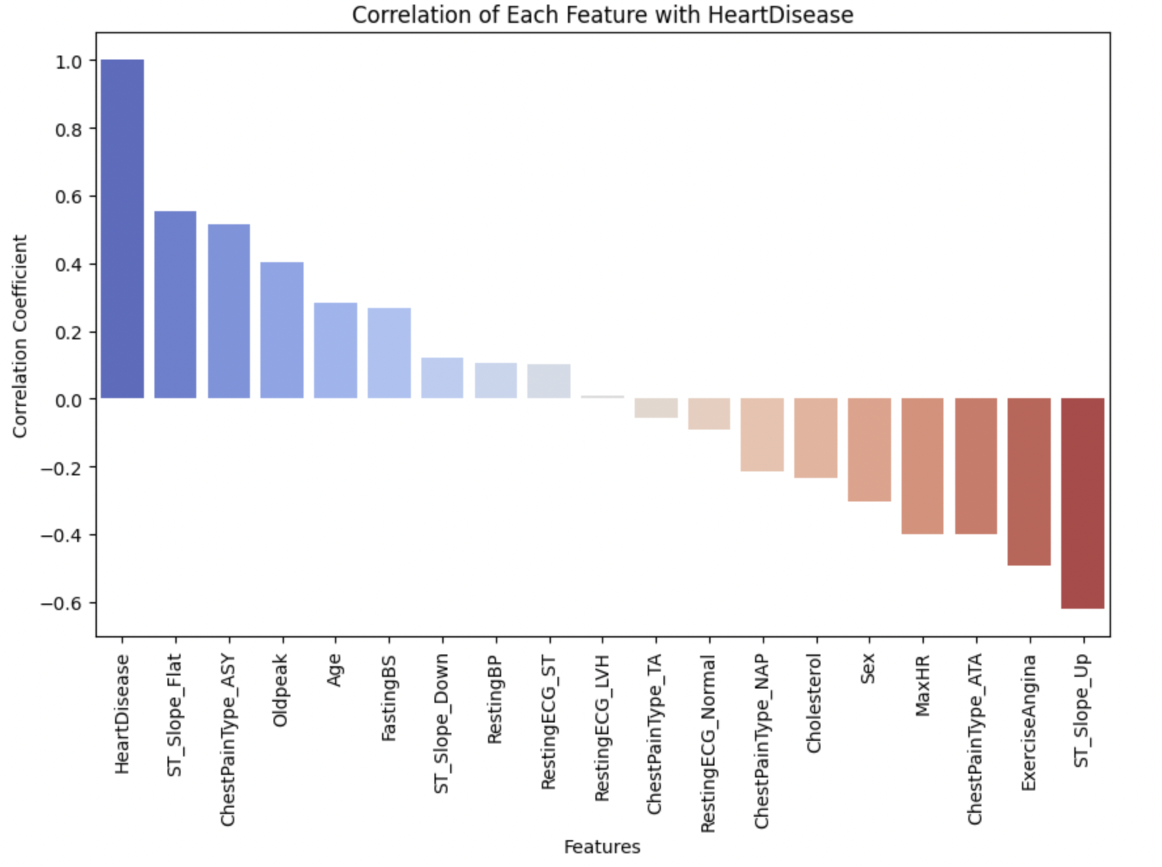
DATA PREPROCESSING
Data Preprocessing Steps:
Encoded Categorical Features: (Binary Variables)
'Sex' encoded as 0 (M) and 1 (F)
'ExerciseAngina' encoded as 0 (Y) and 1 (N)
One-Hot Encoded Features: (Multi category variables)
ChestPainType, RestingECG, ST_Slope
Correlation Analysis:
Identified top features correlated with 'HeartDisease':
Missing Values
No missing values in a data
Data Splitting:
Split data into (75%) training and (25%) testing

Slide 5
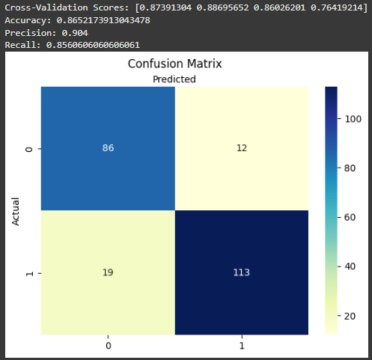
LOGISTIC REGRESSION
4 fold Cross-validation: Ranges from 76% to 88%
Accuracy: 86%
From the matrix:
The model correctly classified a total of 86 (True Negatives) + 113 (True Positives) = 199 instances.
It misclassified a total of 12 (False Positives) + 19 (False Negatives) = 31 instances.

Slide 6
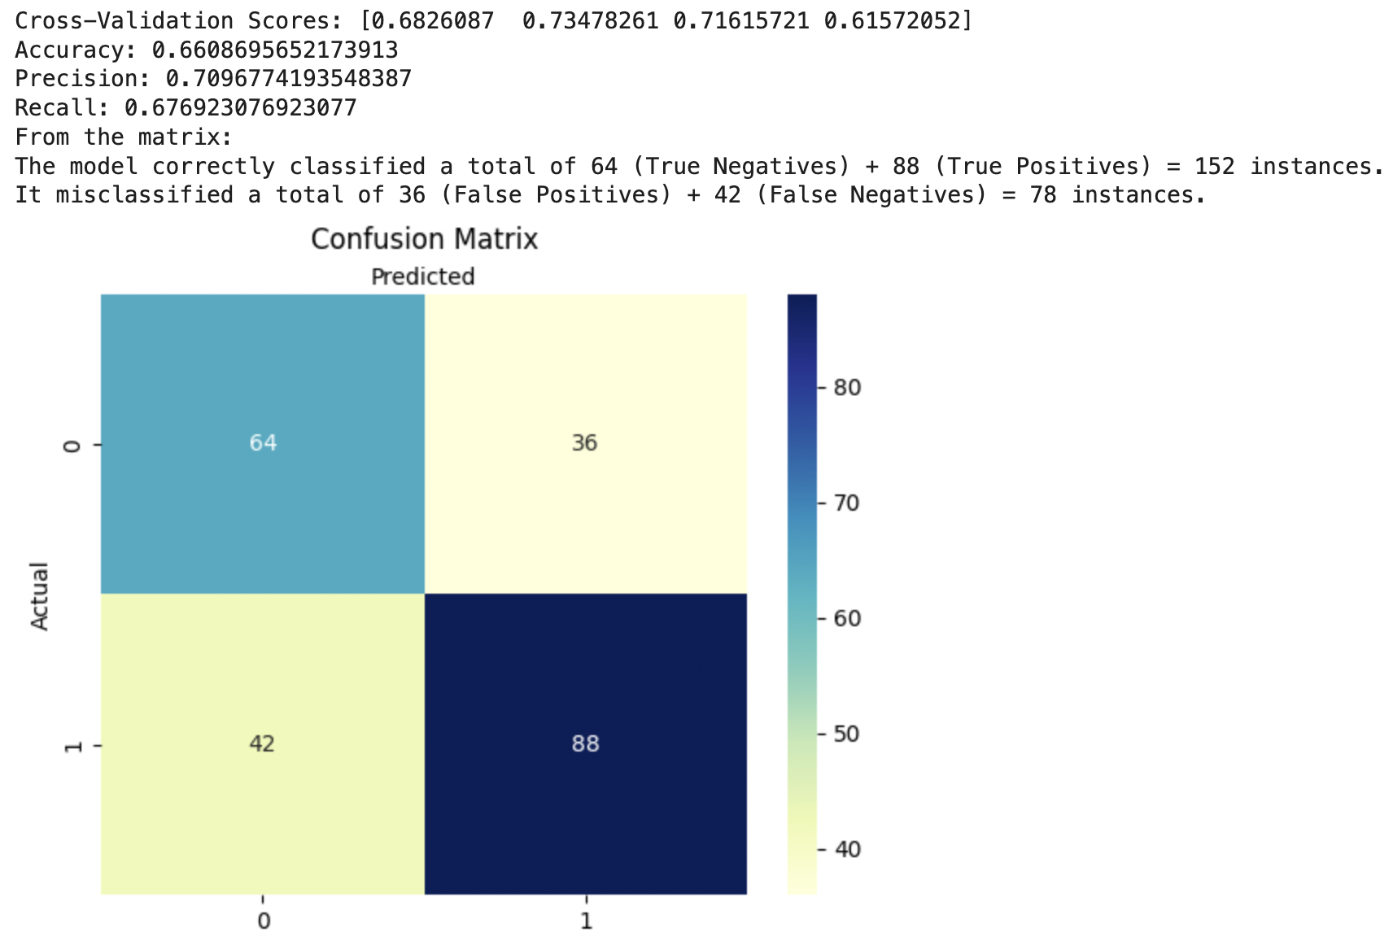
K-NEAREST NEIGHBOURS
Algorithm: KNN with n_neighbors set to 3
Cross-Validation Scores:
Scores: [0.683, 0.735, 0.716, 0.616] Moderate accuracy across folds
Performance Metrics:
Accuracy: 66.1%
Precision: 70.97%
Recall: 67.69%
Confusion Matrix:
The model correctly classified a total of 64 + 88 = 152 instances.
It misclassified a total of 36 + 42 = 78 instances.
Conclusion:
KNN performs reasonably well but can be improved by tuning parameters like neighbors or distance metrics.

Slide 7
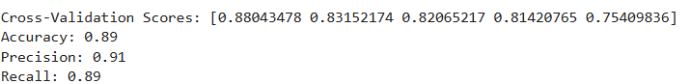
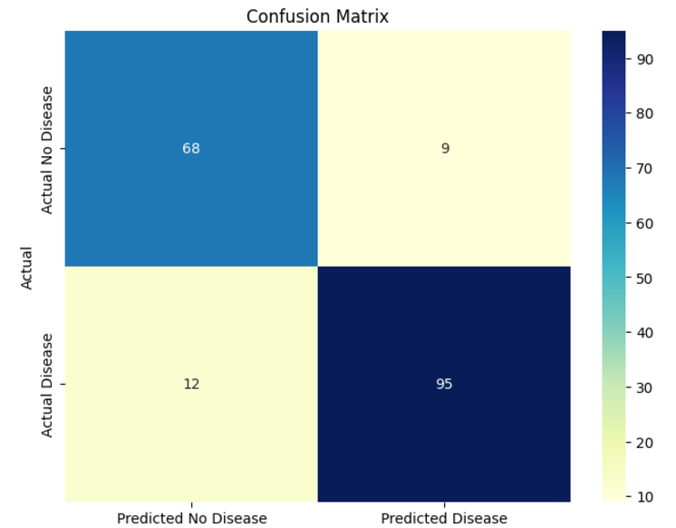
RANDOM FOREST
Accuracy = 89%
From the matrix:
The model correctly classified a total of 68 (True Negatives) + 95 (True Positives) = 163 instances.
It misclassified a total of 9 (False Positives) + 12 (False Negatives) = 21 instances.

Slide 8
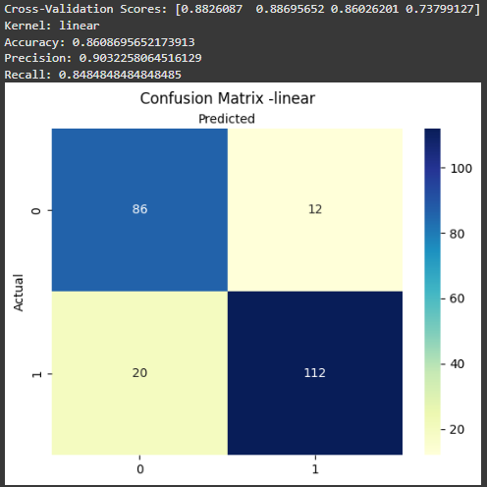
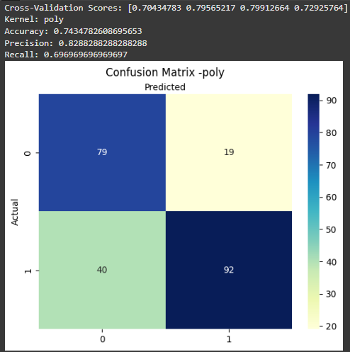
SUPPORT VECTOR MACHINES (Linear & Poly)
4 fold Cross-validation: Ranges from 73% to 88%
Accuracy: 86%
(Linear) From the matrix:
The model correctly classified a total of 86 (True Negatives) + 112 (True Positives) = 198 instances.
It misclassified a total of 12 (False Positives) + 20 (False Negatives) = 32 instances.
4 fold Cross-validation: Ranges from 70% to 79%
Accuracy: 74%
(Poly) From the matrix:
The model correctly classified a total of 79 (True Negatives) + 92 (True Positives) = 171 instances.
It misclassified a total of 19 (False Positives) + 40 (False Negatives) = 59 instances.

Slide 9
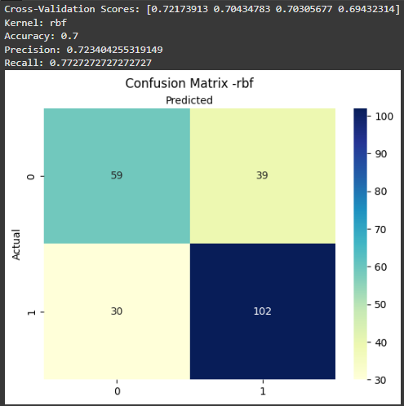
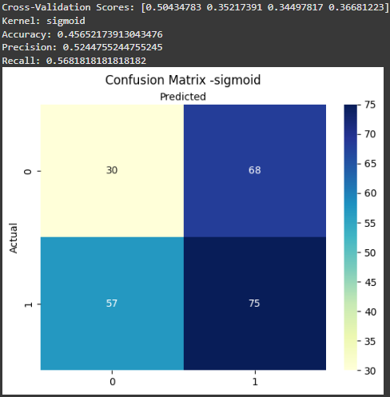
SUPPORT VECTOR MACHINES (RBF & Sigmoid)
4 fold Cross-validation: Ranges from 69% to 72%
Accuracy: 70%
(Rbf) From the matrix:
The model correctly classified a total of 59 (True Negatives) + 102 (True Positives) = 161 instances.
It misclassified a total of 39 (False Positives) + 30 (False Negatives) = 69 instances.
4 fold Cross-validation: Ranges from 34% to 50%
Accuracy: 45%
(Sigmoid) From the matrix:
The model correctly classified a total of 30 (True Negatives) + 75 (True Positives) = 105 instances.
It misclassified a total of 68 (False Positives) + 57 (False Negatives) = 125 instances.

Slide 10
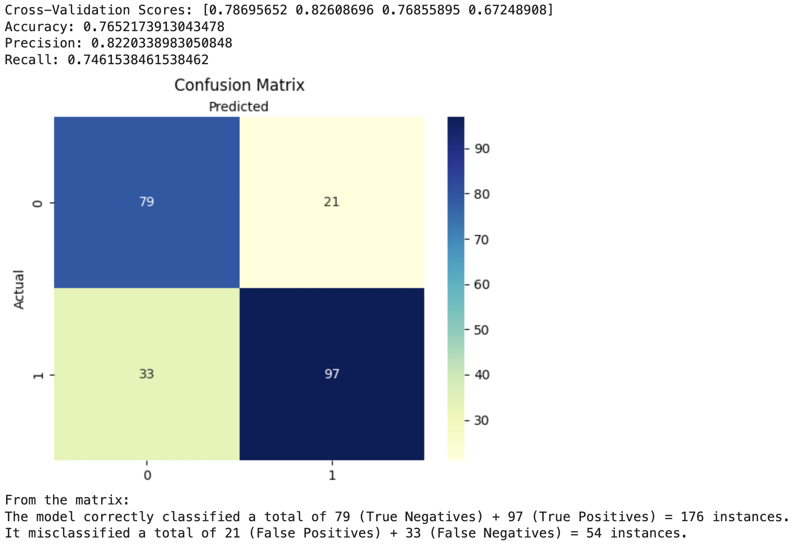
DECISION TREES
Cross-Validation Scores:
Scores: [0.787, 0.826, 0.769, 0.672] Moderate performance across folds.
Performance Metrics:
Accuracy: 76.5%
Precision: 82.2%
Recall: 74.6%
Confusion Matrix:
The model correctly classified a total of 79 + 97 = 176 instances.
It misclassified a total of 21 + 33 = 54 instances.
Conclusion:
The Decision Tree model shows fair accuracy with strong precision but slightly lower recall, making it good at reducing false positives but potentially missing some true positives.

Slide 11
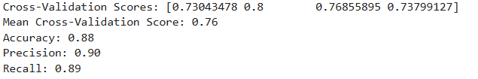
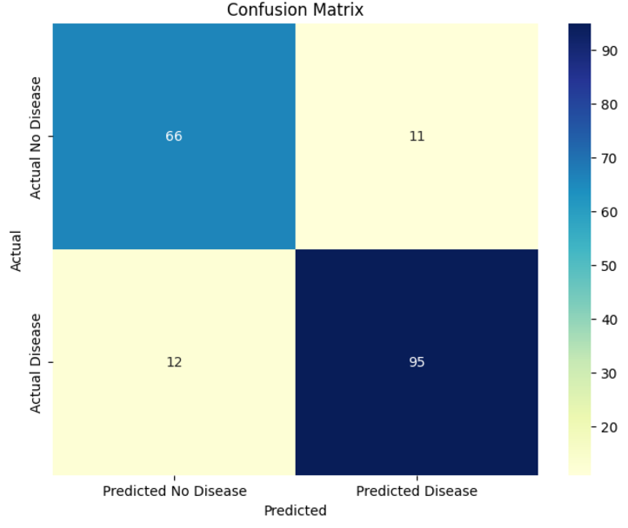
STOCHASTIC GRADIENT DESCENT
Accuracy = 88%
From the matrix:
The model correctly classified of a total of 66 (True Negatives) + 95 (True Positives) = 161 instances.
It is misclassified of total of 11 (False Positives) + 12 (False Negatives) = 23 instances

Slide 12
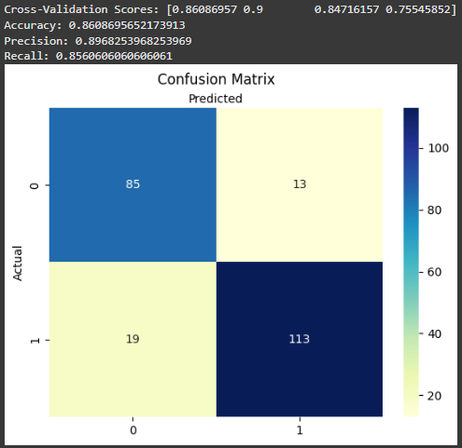
NAIVE BAYES
4 fold Cross-validation: Ranges from 75% to 90%
Accuracy: 86%
From the matrix:
The model correctly classified a total of 85 (True Negatives) + 113 (True Positives) = 198 instances.
It misclassified a total of 13 (False Positives) + 19 (False Negatives) = 32 instances.

Slide 13
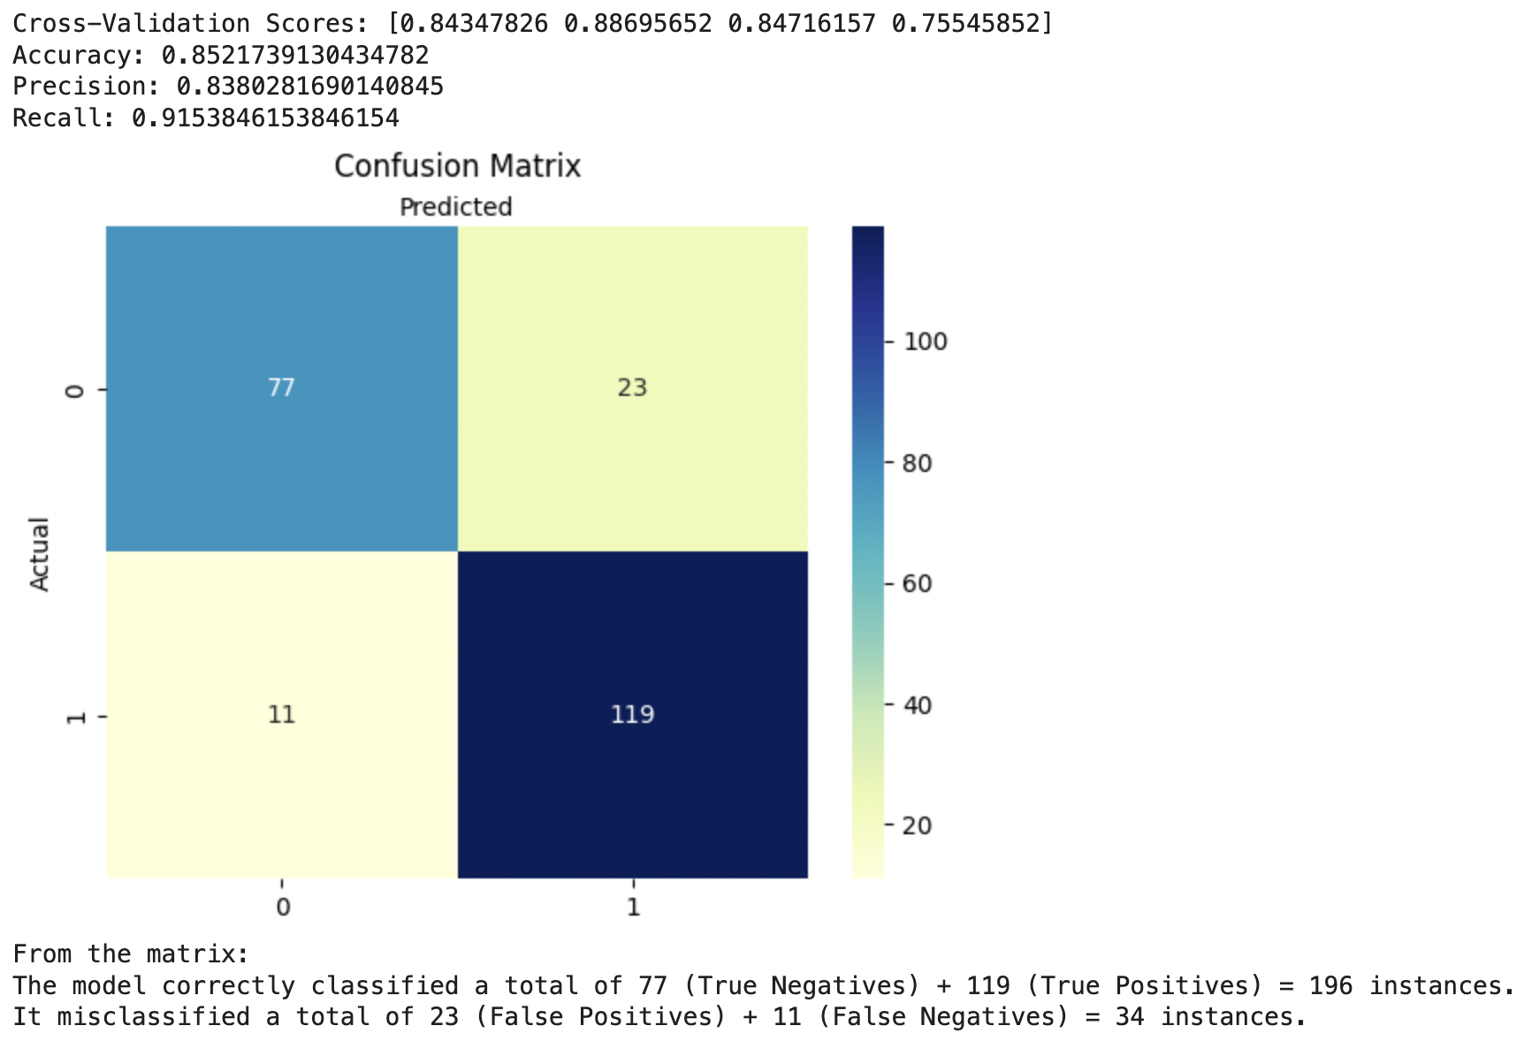
MULTILAYER PERCEPTRON
Architecture: Hidden layers (25, 15 neurons)
Cross-Validation Scores:
Scores: [0.843, 0.887, 0.847, 0.755] High accuracy across different folds, indicating stable performance.
Performance Metrics:
Accuracy: 85.2%
Precision: 83.8%
Recall: 91.5%
Confusion Matrix:
The model correctly classified a total of 77 + 119 = 196 instances.
It misclassified a total of 23 + 11 = 34 instances.
Conclusion:
The MLP model performs very well with an accuracy of 85.2%, high precision, and excellent recall. It has a balanced performance, correctly identifying most positives while keeping false positives at a manageable level.

Slide 14
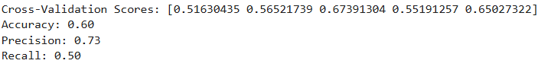
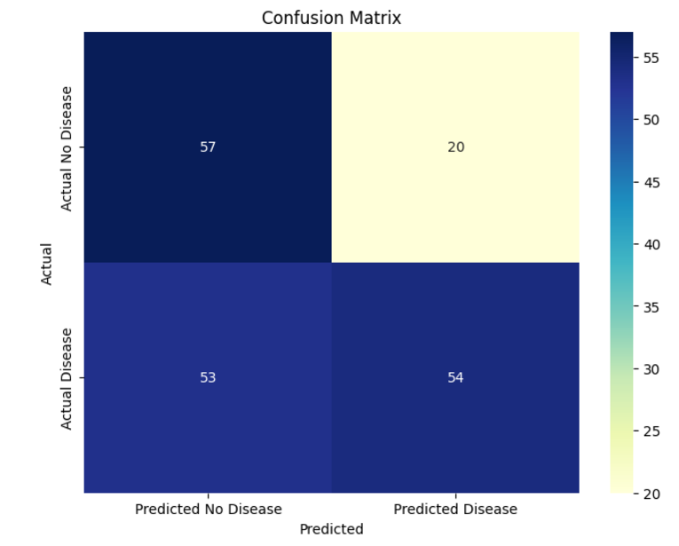
PERCEPTRON
Accuracy = 60 %
From the matrix:
The model correctly classified a total of 57 (True Negatives) + 54 (True Positives) = 111 instances.
It misclassified a total of 20 (False Positives) + 53 (False Negatives) = 73 instances.

Slide 15
Evaluation Metrics
MODEL | ACCURACY | PRECISION | RECALL
Logistic Regression | 86.5% | 90.4% | 85.6%
KNN | 66% | 71% | 68%
Random Forest | 89% | 91% | 89%
SVM-Linear | 86% | 90.3% | 84%
SVM-Poly | 73% | 82% | 69%
SVM-Rbf | 70% | 72% | 77%
SVM-Sigmoid | 45% | 52% | 56%
Decision Trees | 77% | 82% | 75%
Stochastic Gradient Descent | 88% | 90% | 89%
Naive Bayes | 86% | 89% | 85%
Perceptron | 60% | 73% | 50%
MLP | 85% | 84% | 92%

Slide 16
CONCLUSION
Best Models: Random Forest (89%) and Stochastic Gradient Descent (88%) excel in accuracy, precision, and recall, making them the top choices for reliable heart disease prediction.
High Recall: MLP’s high recall (92%) is ideal for applications where identifying all positive cases is crucial, even with a slight trade-off in precision.
Underperformers: KNN and Perceptron lag in all metrics, with KNN at 66% accuracy and Perceptron at 60%, highlighting their limitations for this dataset.
Balanced Option: Naive Bayes (86% accuracy) provides a good mix of simplicity and predictive strength, but falls short of the top-performing models.

Slide 17
THANK YOU!

